Slide 1
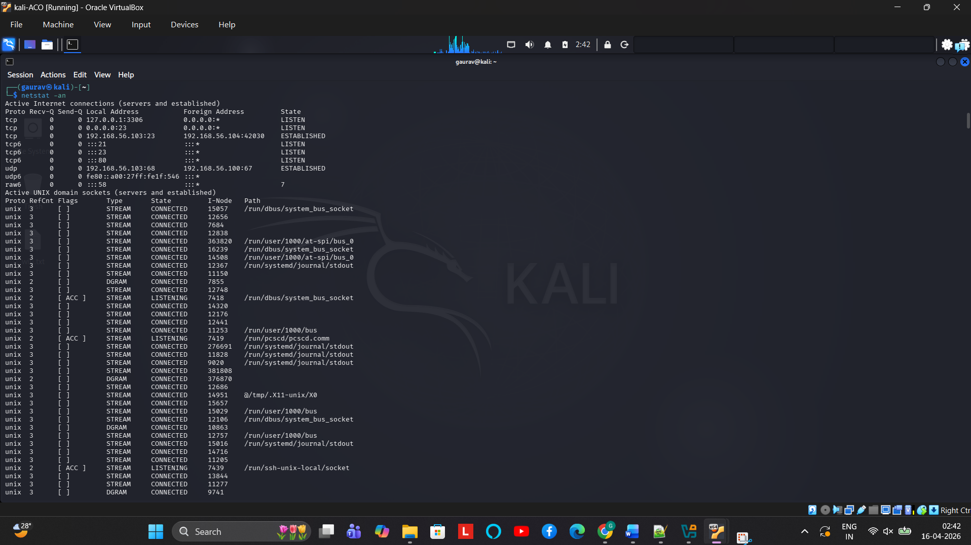
PH4- netstat –an : ALL CONNECTIONS

Slide 2
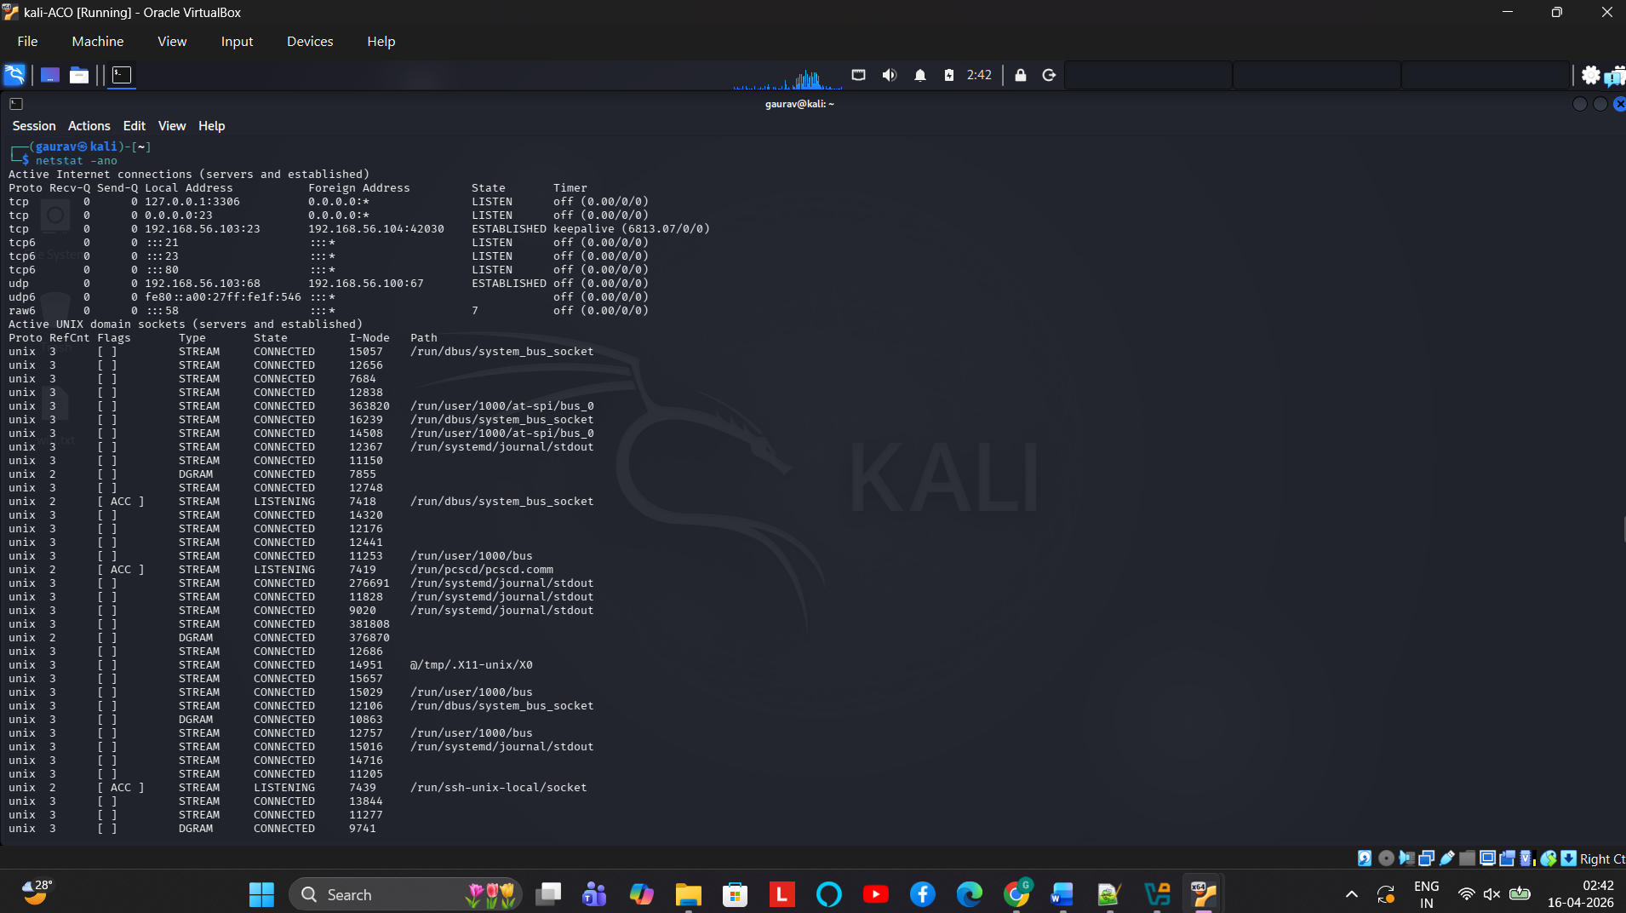
PH4- netstat –ano :ACTIVE INTERNET CONNECTIONS

Slide 3
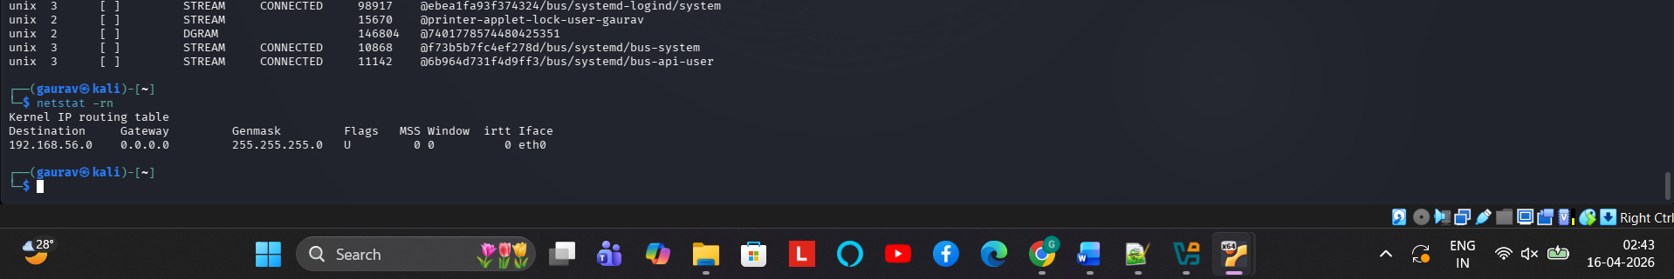
PH4- netstat –rn routing table

Slide 4
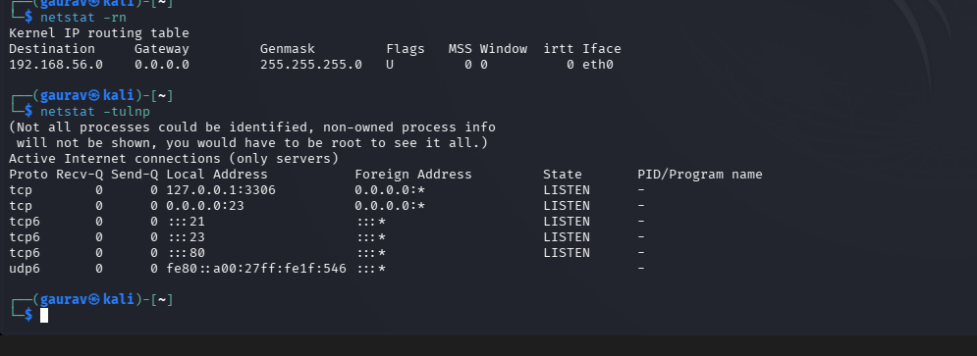
PH4- netstat –tulnp : LISTENING PORTS

